Slide 2
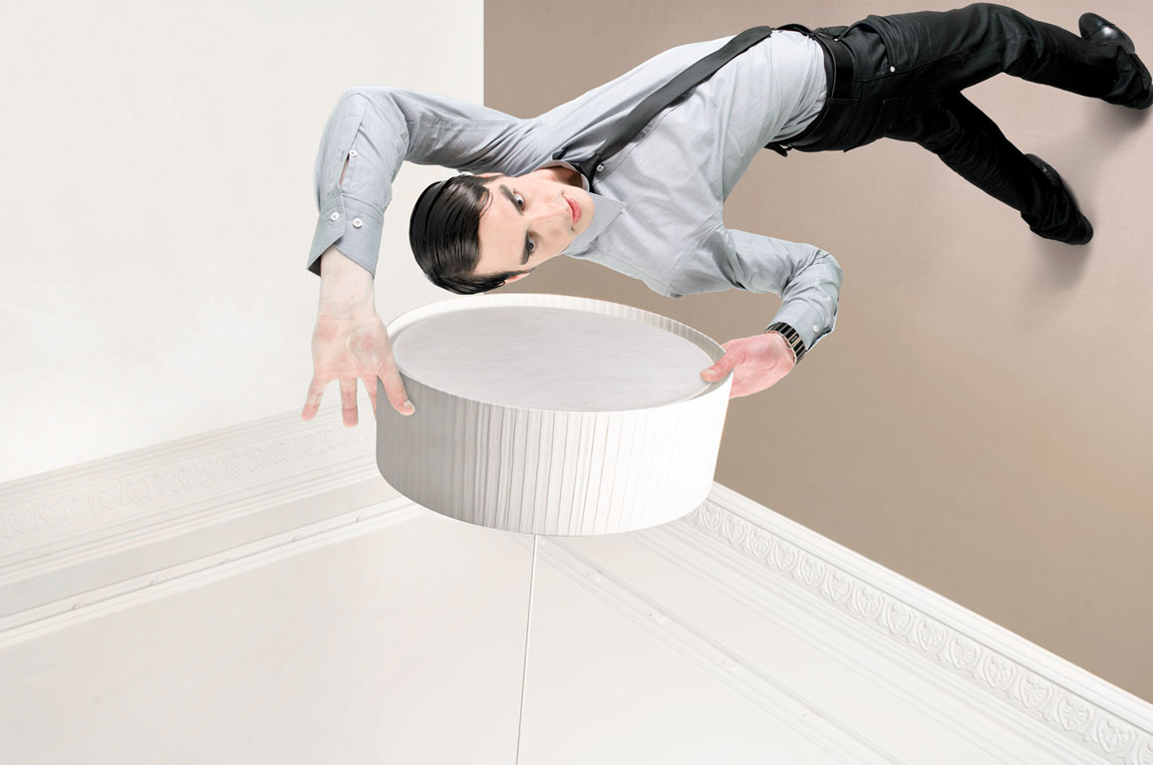
Brand & Material

Slide 3
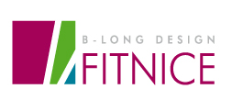

BRAND
FITNICE has been inspired by the design of architect’s Cerda Eixample district in Barcelona: a new grid pattern as an example of urban development that made urban life easier.
The colours used in the logo represent nature, providing impact and modernity.
This logo transmits the international values of Barcelona’s brand (“Gaudi’s mosaic”).
Modern / Creative / Trendy / Cosmopolitan / Mediterranean

Slide 4
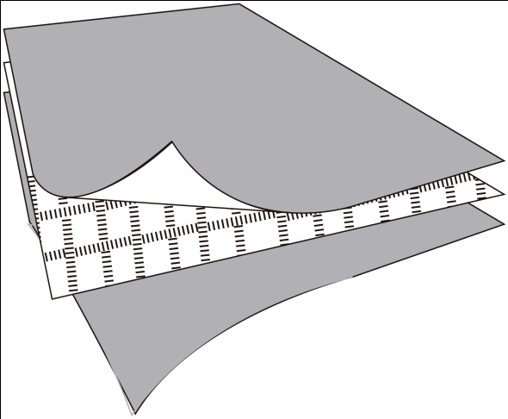
MATERIAL
FITNICE is composed of woven vinyl coated High Tenacity Polyester (HT PES) yarns, that provide durability and very easy care.
The fabric is glued over a backing of recycled vinyl which contributes to high Dimensional Stability and a high level of thermal and acoustic insulation.
            FITNICE FLOOR is:
            - Fire Resistant (Bfl, s1)
            - Recyclable and recycled
            - Weather resistant (exterior use)
            - Antiacarus
            - Antibacterial
HT PES
PVC
Vinyl
Fiber Glass
Vinyl

Slide 5

MATERIAL – RANGE
FITNICE FLOOR:
Wicker
Rolls of 20 ml (2,00 mt width )
Tiles of 50x5 cm (also available in looselay tiles)
Opera Prima
Rolls of 20 ml (2,00 mt width )
Tiles of 50x50 cm (also available in looselay tiles)
Chroma
Rolls of 20 ml (2,00 mt width )
Tiles of 50x50 cm (also available in looselay tiles)
Panama
Tiles of 50x50 cm (also available in looselay tiles)

Slide 6
APPLICATIONS
FITNICE FLOOR can be applied in:
    Hotels / Restaurants / Bars
    Sport Clubs
    Shops
    Offices
    Schools / Universities /
    Museum / Gallery / Library
    Trade Shows
    Nautical and Aeronautics Industry.

Slide 7
CERTIFICATES
Fitnice is a brand of Vertisol, a European manufacturer equipped with the ISO 14001, EMAS, Oeko-Tex® and Greenguard Children & Schools certifications.
All of its features are guaranteed and backed by the prestigious ISO 9001.
At the same time, Fitnice is manufactured according to sustainable production processes and the Eco-Codice® label, an innovate in-house program for recycling rest materials and residuals.

Slide 8





CERTIFICATES
ISO 9001 Definition: ISO 9001 is a set of internationally agreed standards that provide guidelines for a Quality Management System
ISO 14001 is a standard for environmental management.
The aim of the standard is to reduce the environmental footprint of a business and to decrease the pollution and waste that business produces.
This certificate guarantees that the product has been manufactured in the European Community and under its regulations.
The Eco-Management and Audit Scheme, EMAS, allows voluntary participation in an environmental management.
It aims to promote continuous evaluation and improvements in the environmental performance of participating organizations
The Wheel mark (Mark of Conformity) is the European regulatory marking of all marine equipment, as defined in the Marine Equipment Directive, 96/98/EC, to be placed onboard community ships .

Slide 9



CERTIFICATES
The GREENGUARD Environmental Institute (GEI) has established performance based standards to define goods with low chemical and particle emissions for use indoors, primarily building materials, interior furnishings, furniture, cleaning and maintenance products, electronic equipment, and personal care products.
GREENGUARD Children & Schools Certification program's for testing chemical emissions from building products used in schools, offices and other sensitive environments.
This certification helps to get points to obtain the Leed certification.
The Oeko-Tex® Standard 100 provides the textile and clothing industry with a globally uniform standard for the objective assessment of harmful substances for the first time. Raw materials, intermediate and end products at all stages of processing throughout the manufacturing chain, including accessories, are tested and certified.
This is an in-house ecological program that consists in:
Recycling of production remains produced during the manufacture process.
Production or re-usable packing material
Adding recycled material to floor and wall covering products.

Slide 10
Added Value
Fitnice is a high-tech, comfortable and practical material; that furthermore provides the regular warmth of fabrics.
Long-Lasting.
Easy Cleaning and Maintenance .
Easy to Install.
Trendy.
5 Years Warranty.
CE Certificate.
Green Certificates
Made in CE (100% of the manufacturer process in Spain)

Slide 11
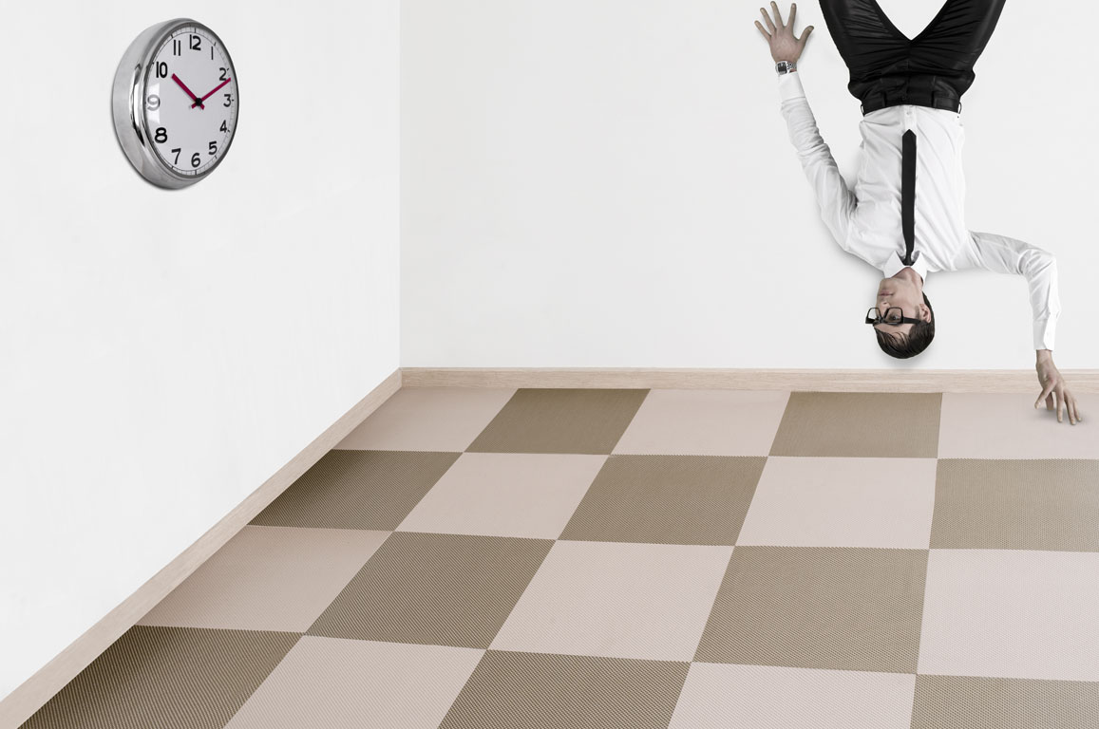
References & Events

Slide 12
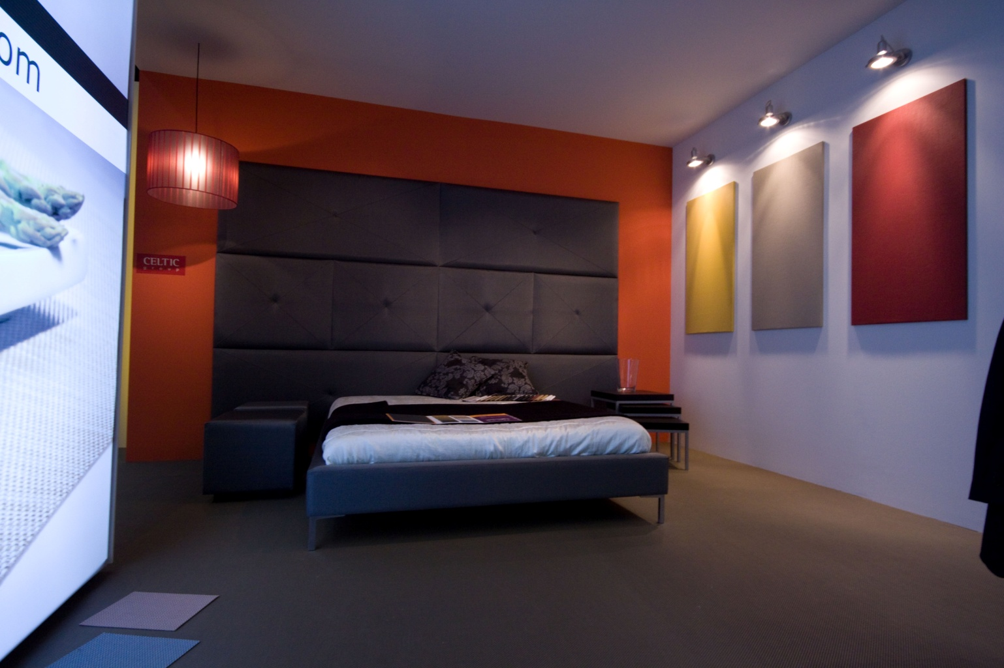
HOSTELCO Stand Fitnice (Barcelona)

Slide 13
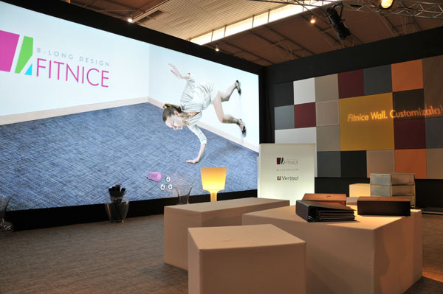
Constumat’09 (Barcelona)

Slide 14
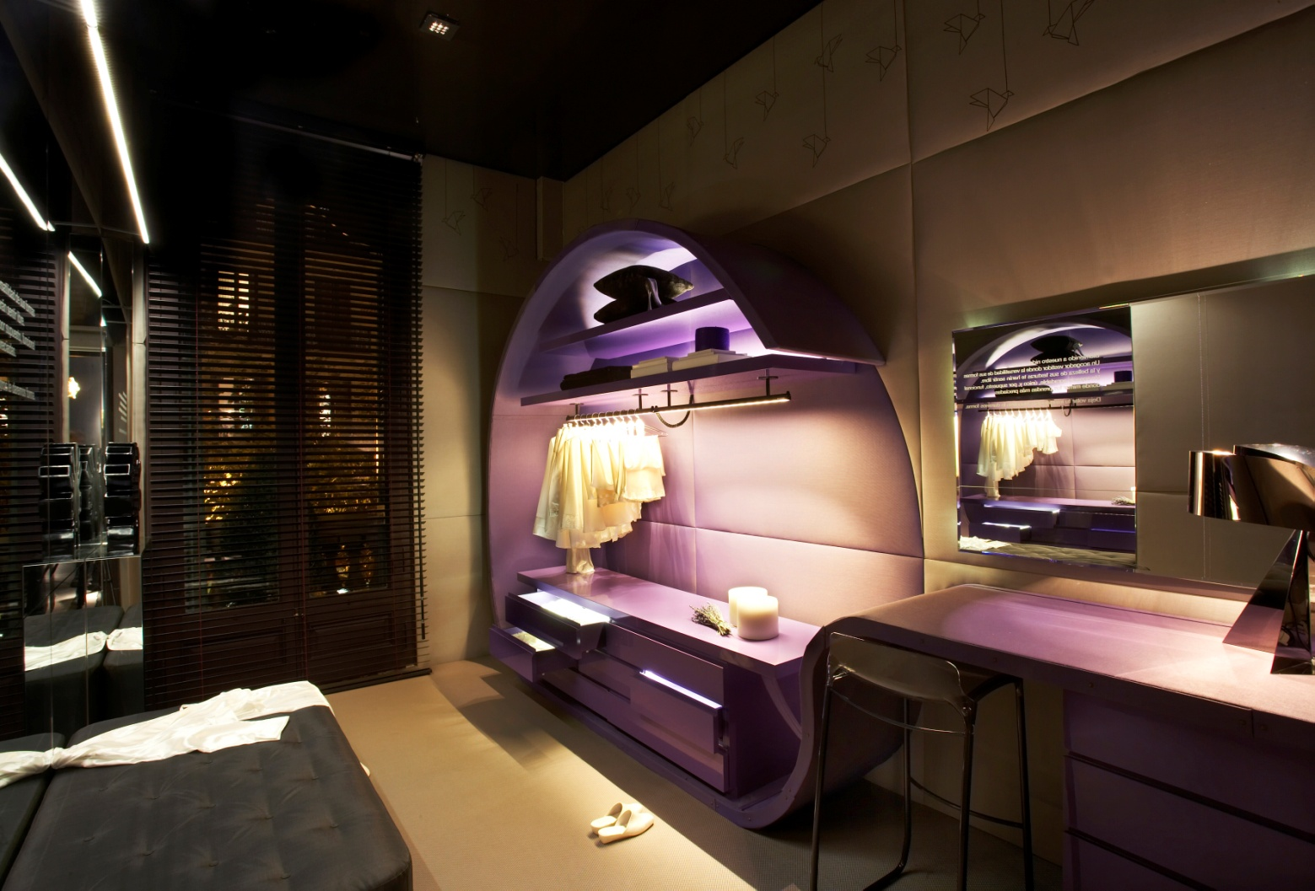
Casa Decor’09 (Barcelona)

Slide 15
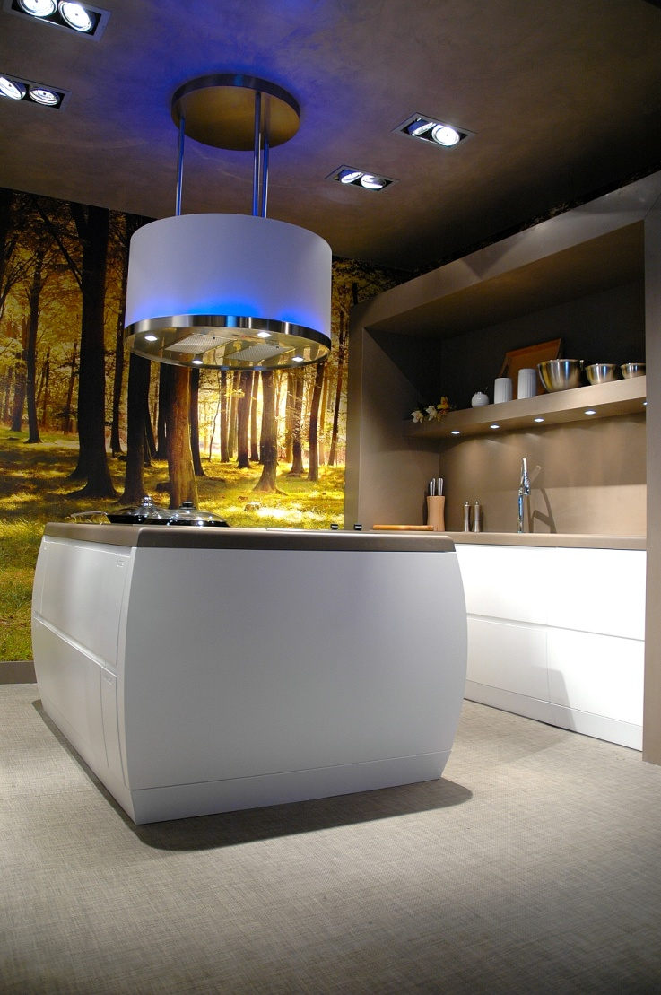
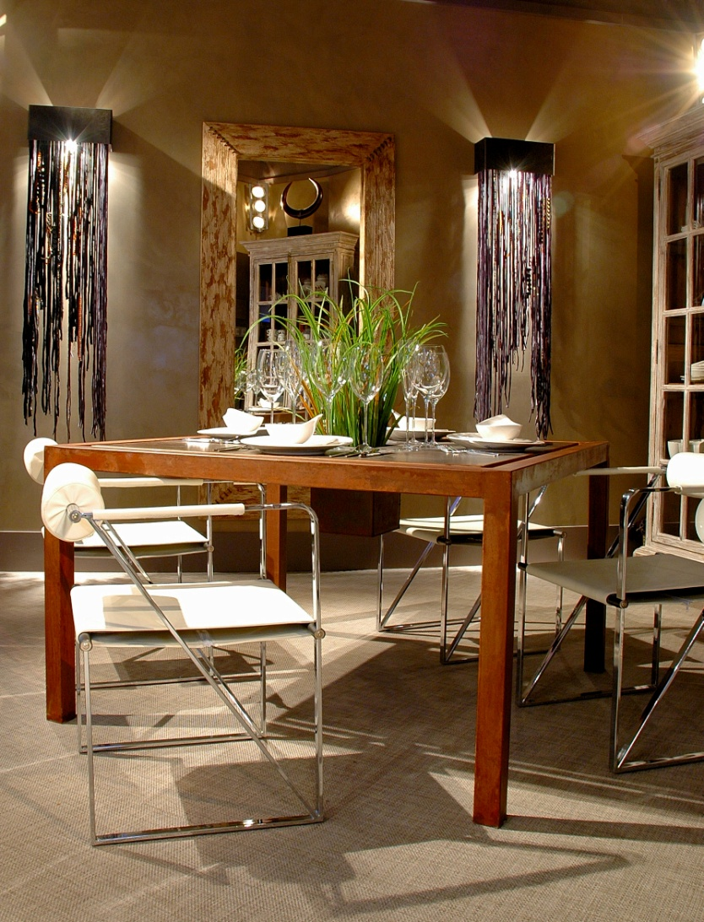
Private house(Barcelona)

Slide 16
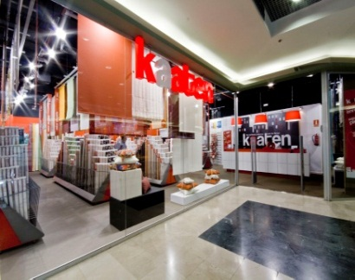
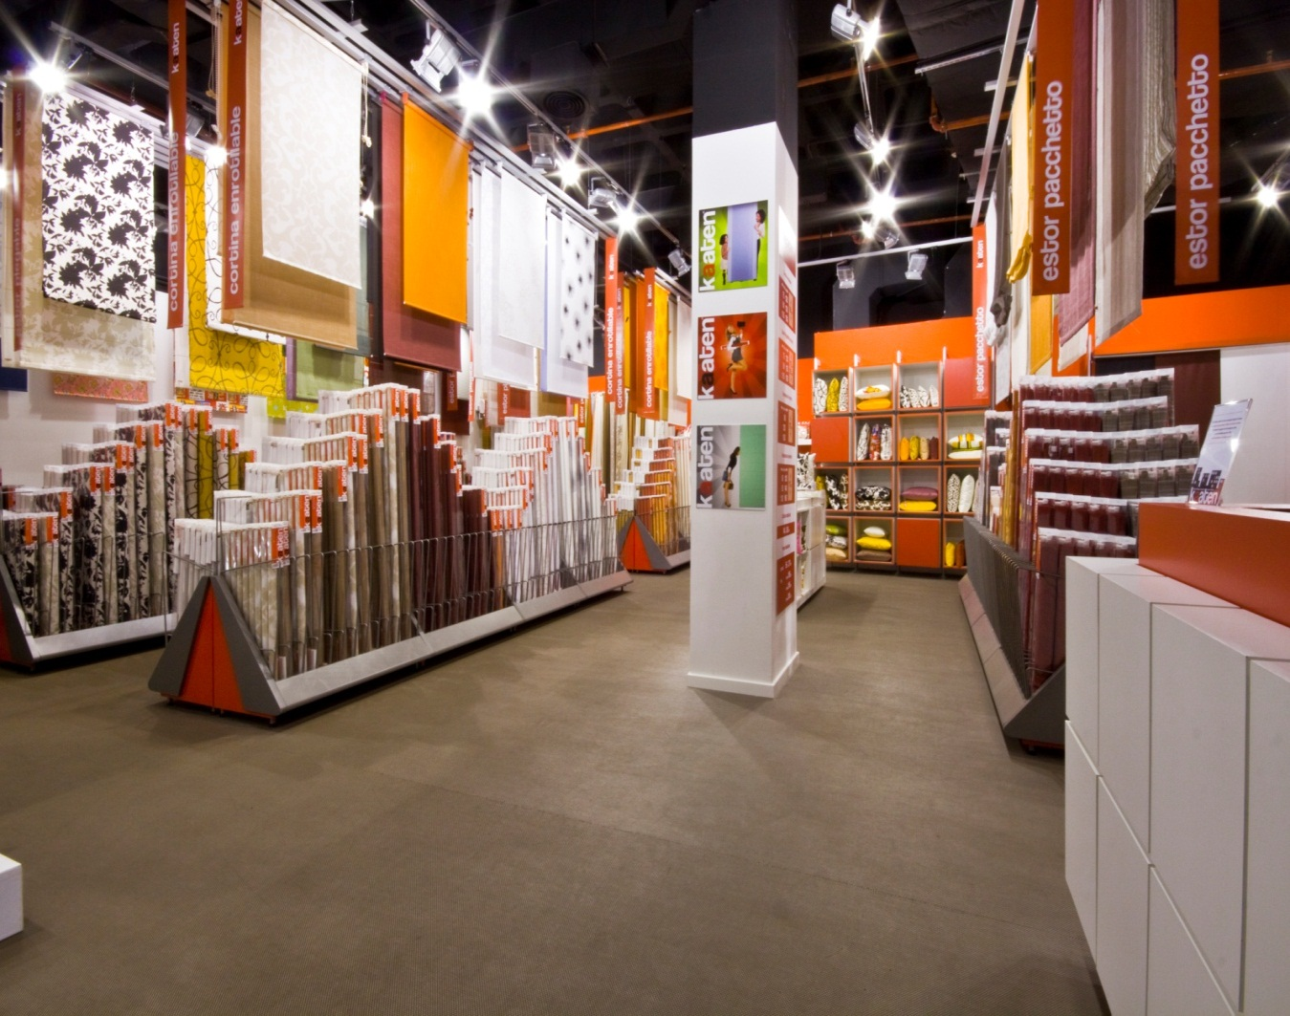
Kaaten’s shop (Barcelona)

Slide 17
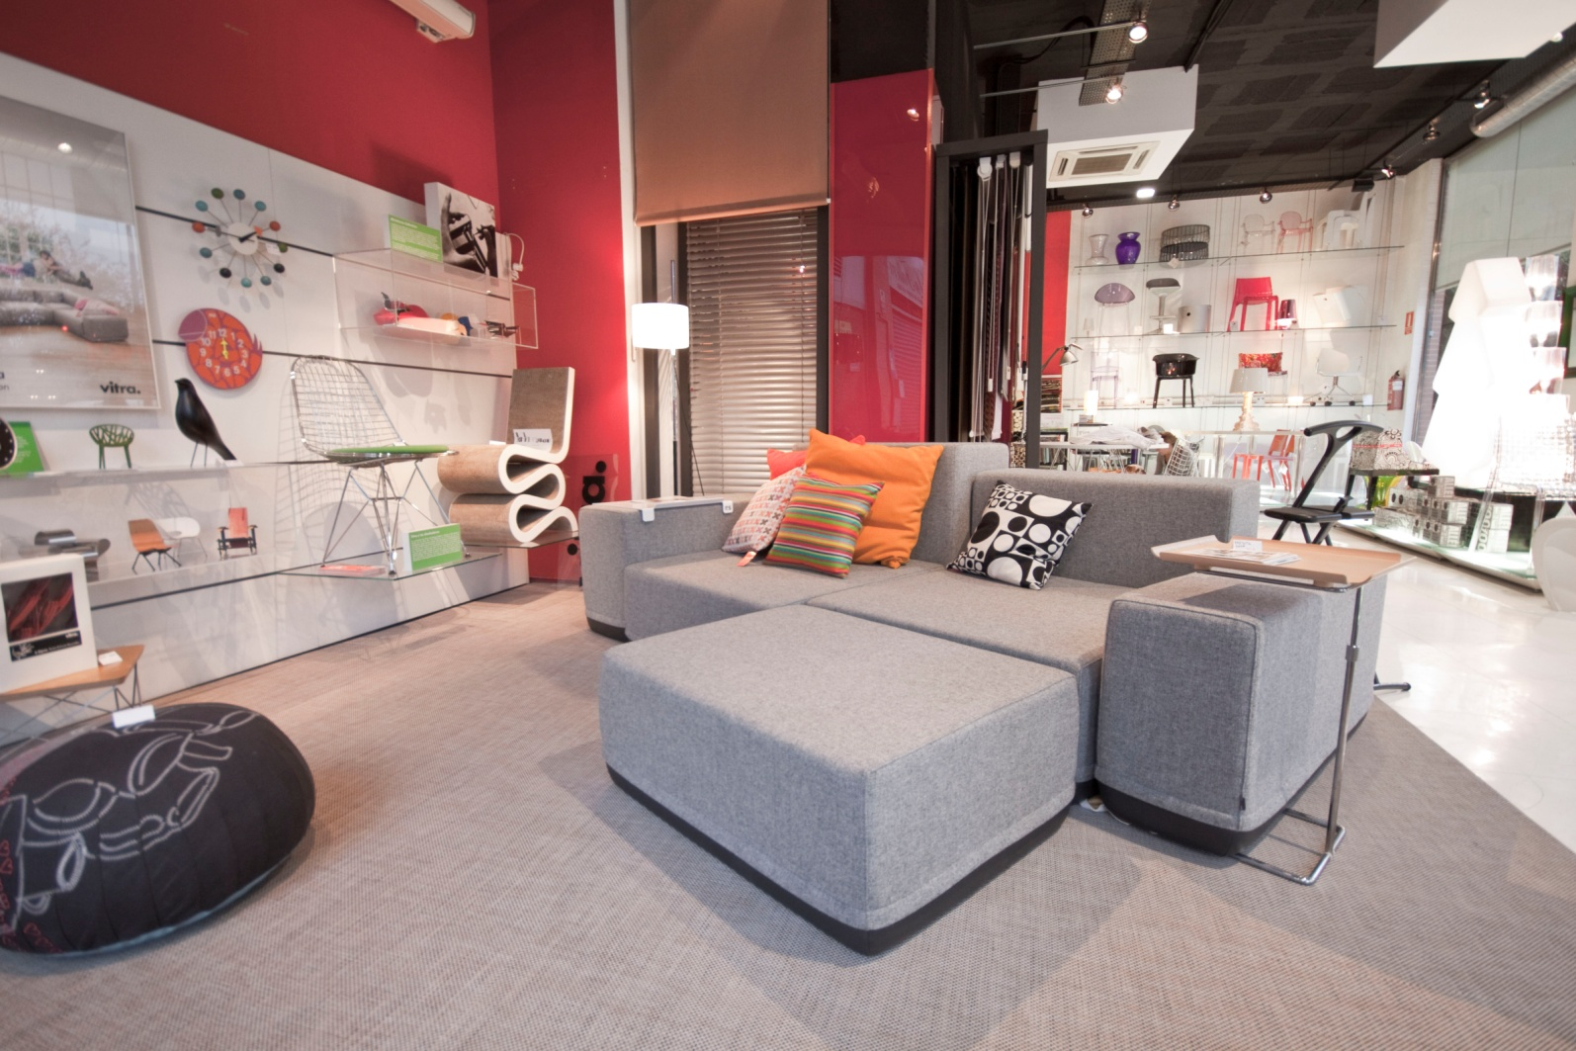
Espacio Plano, Design Shop

Slide 18
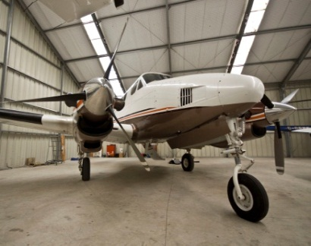
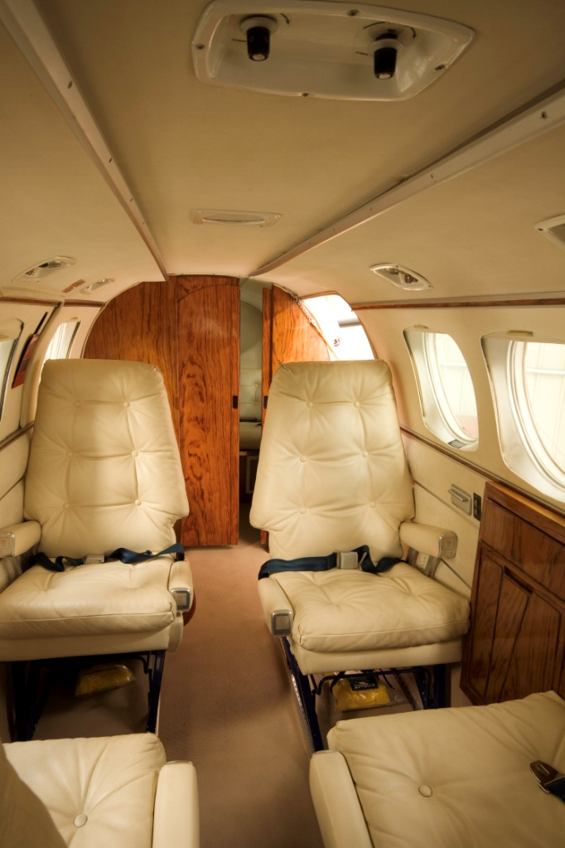
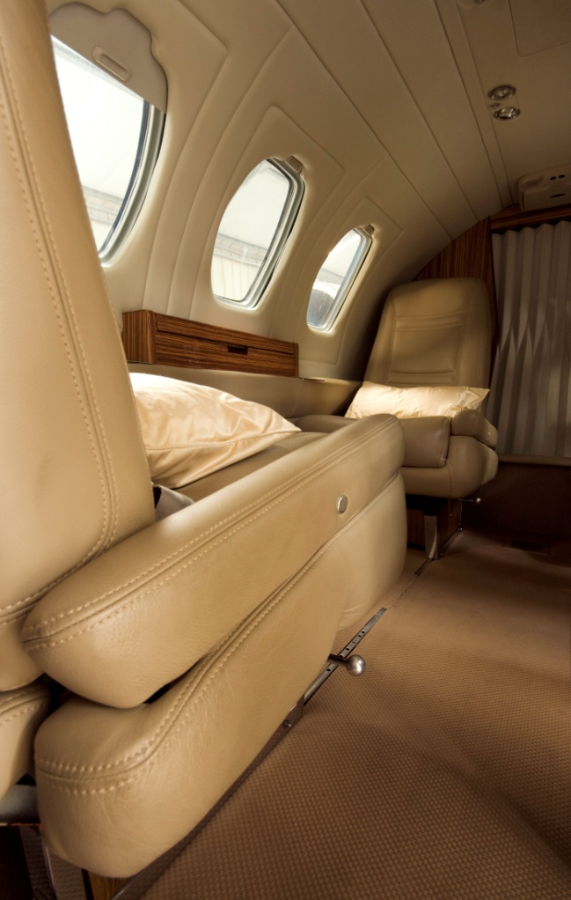
REFERENCES
Private Jet (Barcelona)

Slide 19
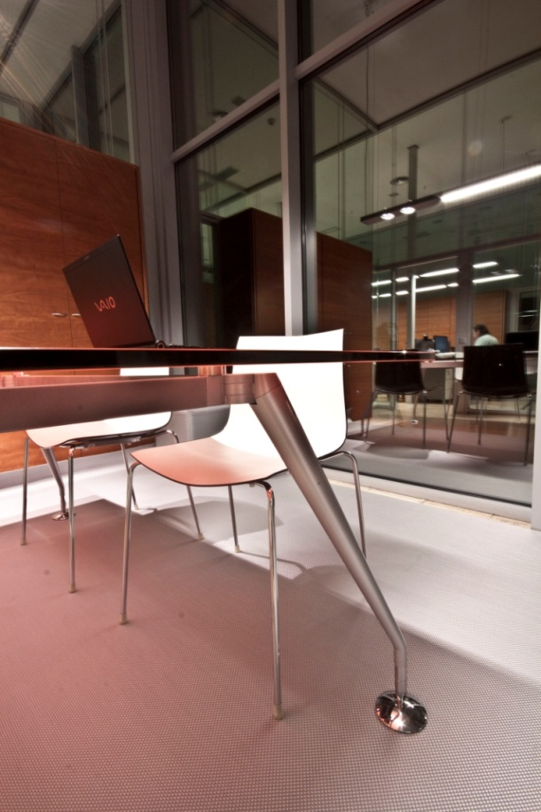
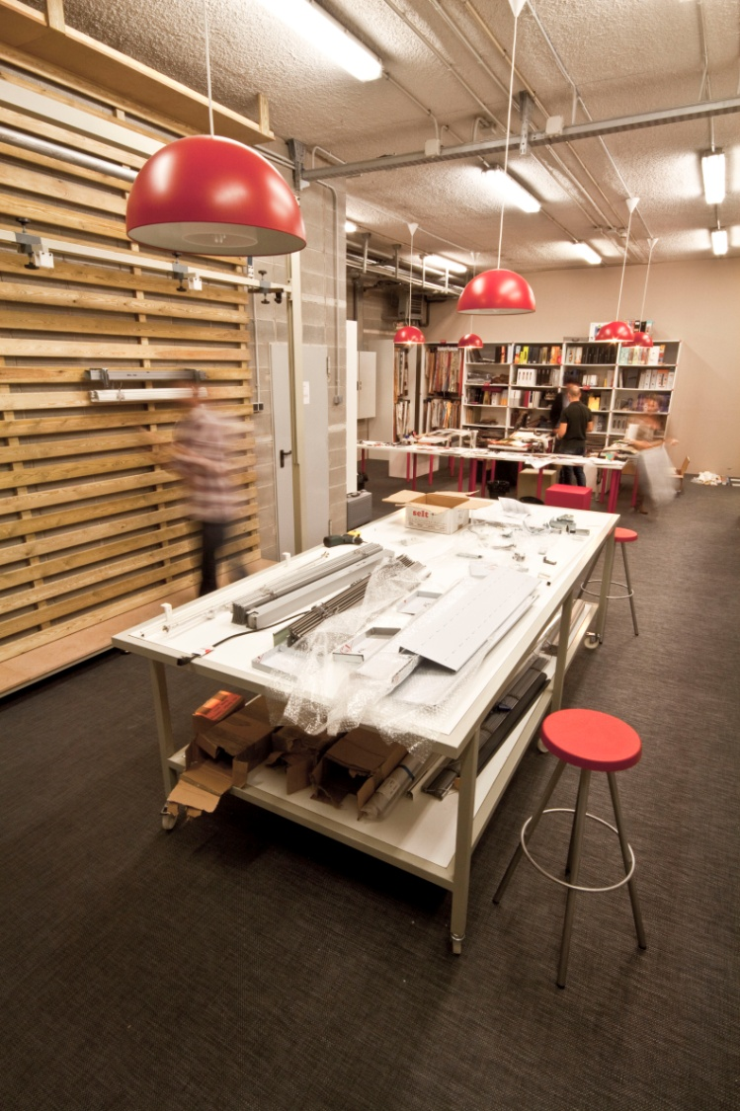
REFERENCES
Private company

Slide 20
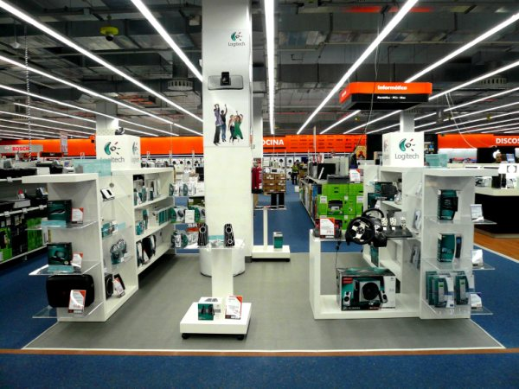
Trade Show - Stand Logitech

Slide 21
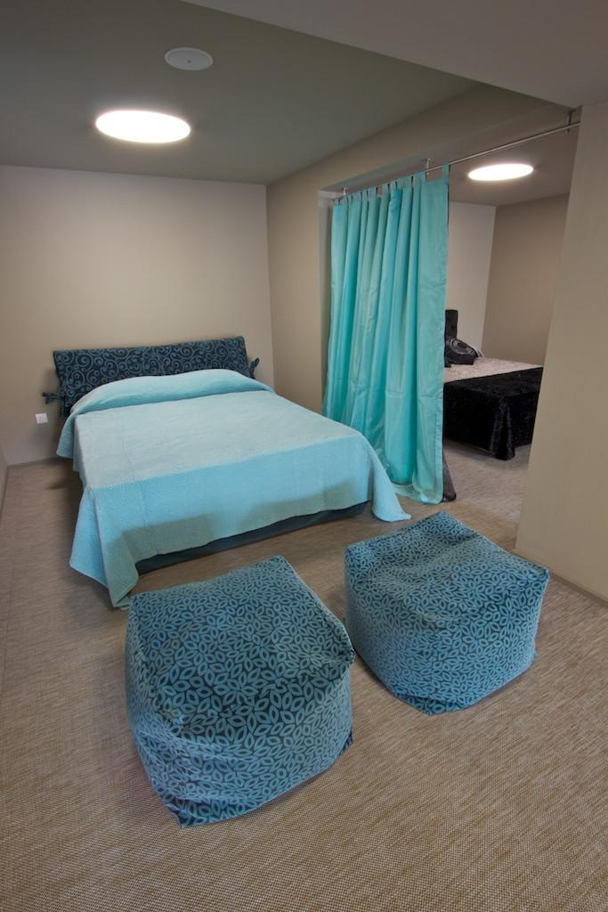
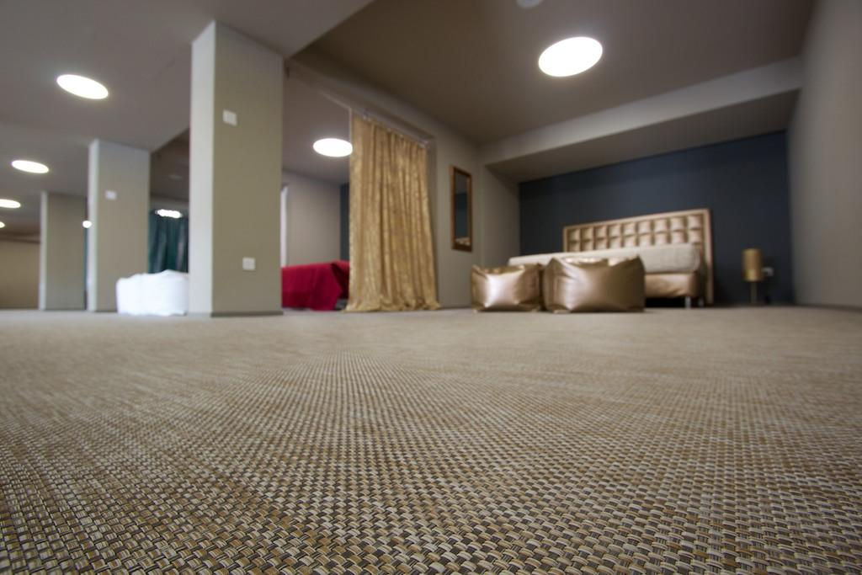
Tempur’s shop (Cyprus)

Slide 22
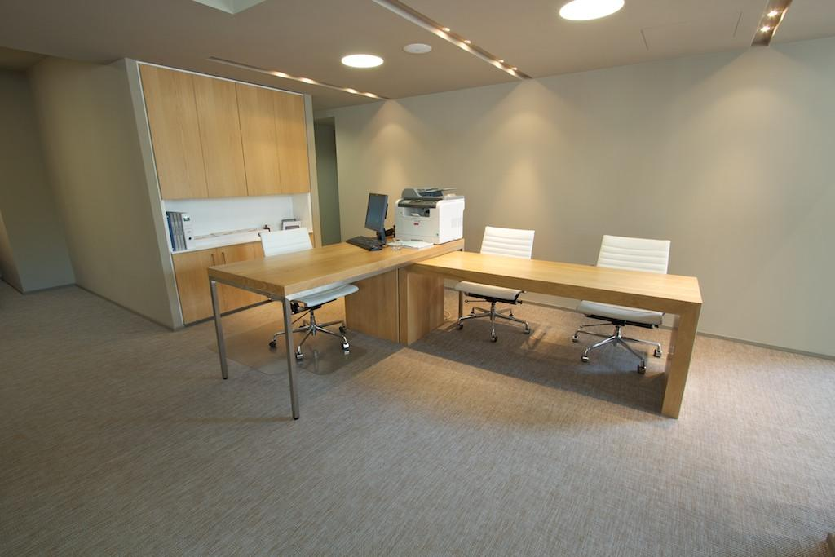
Mekatronic’s offices (Cyprus)

Slide 23
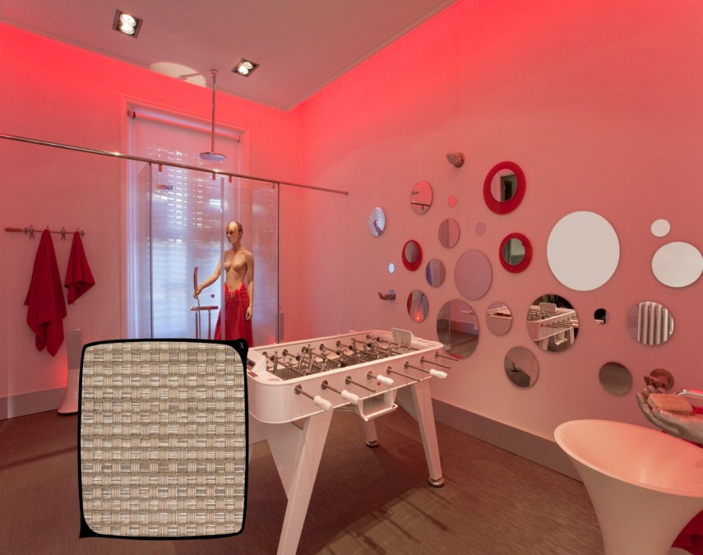
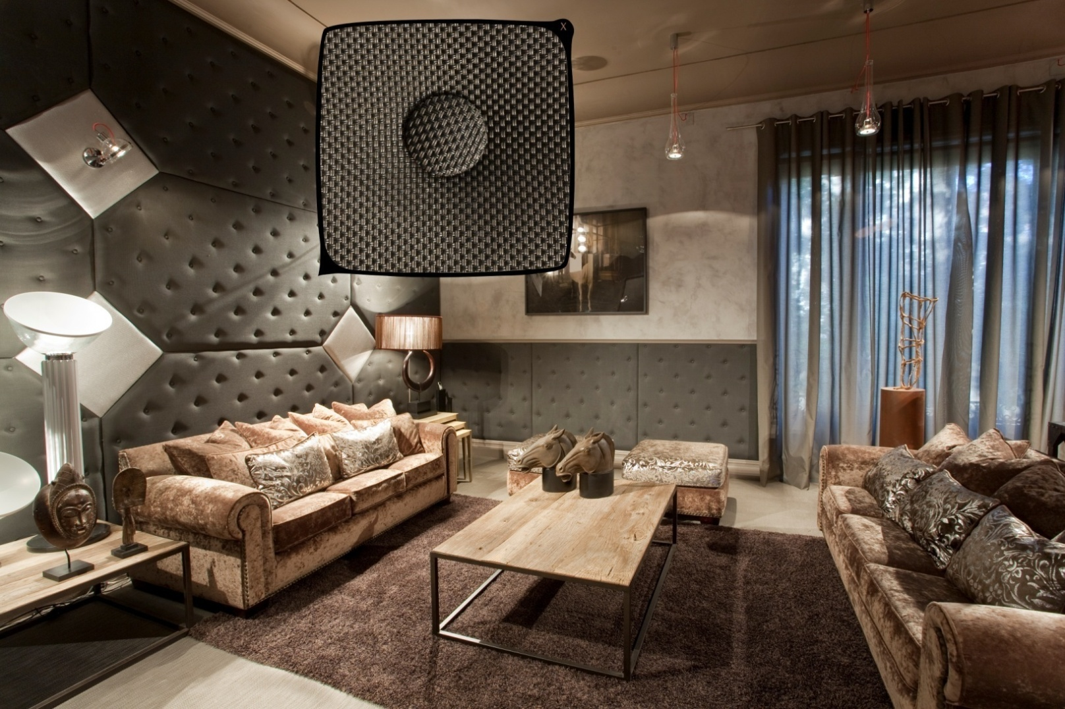
Casa Decor, Madrid

Slide 24
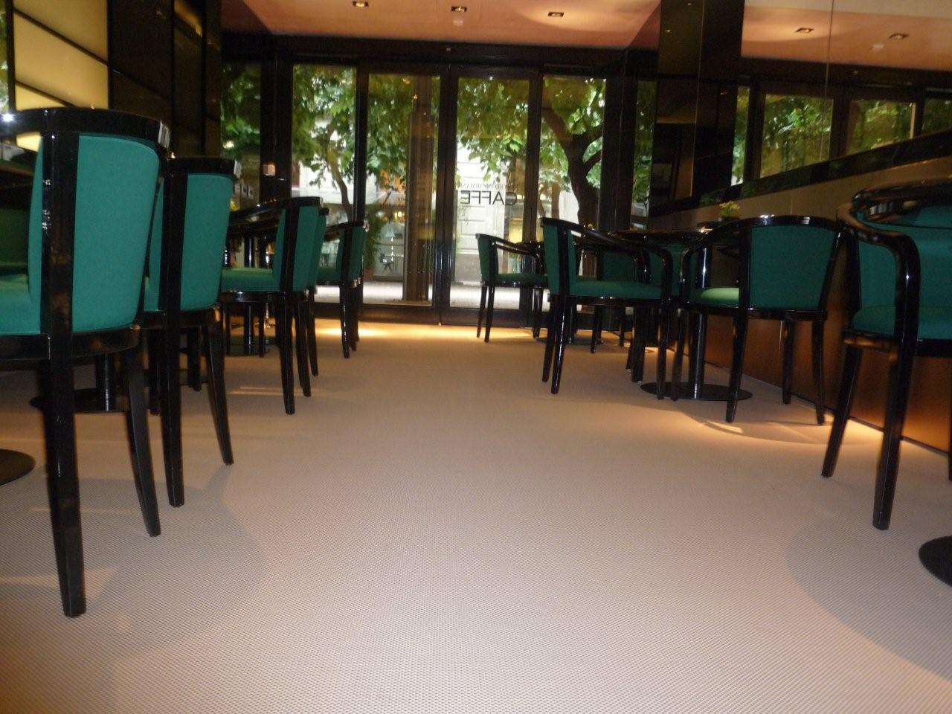
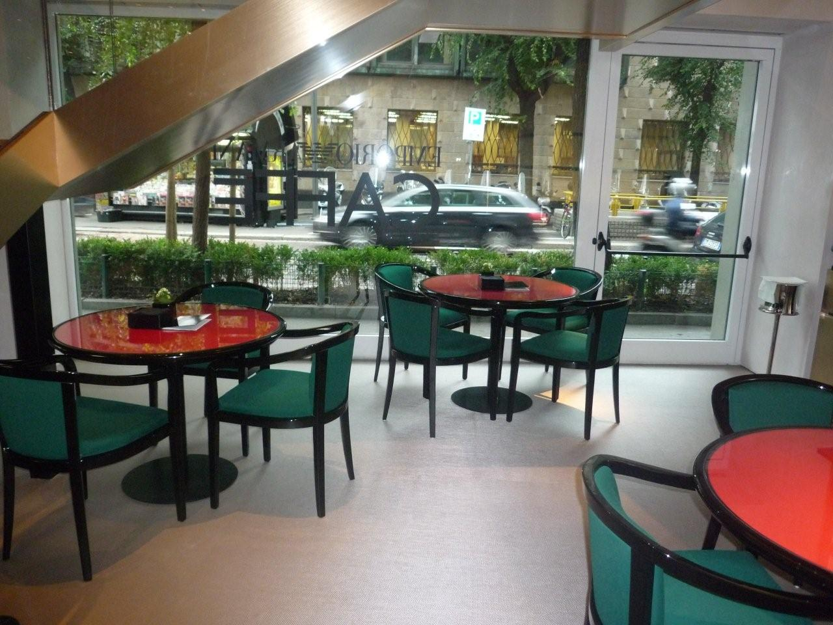
Armani Café (Milano)

Slide 25
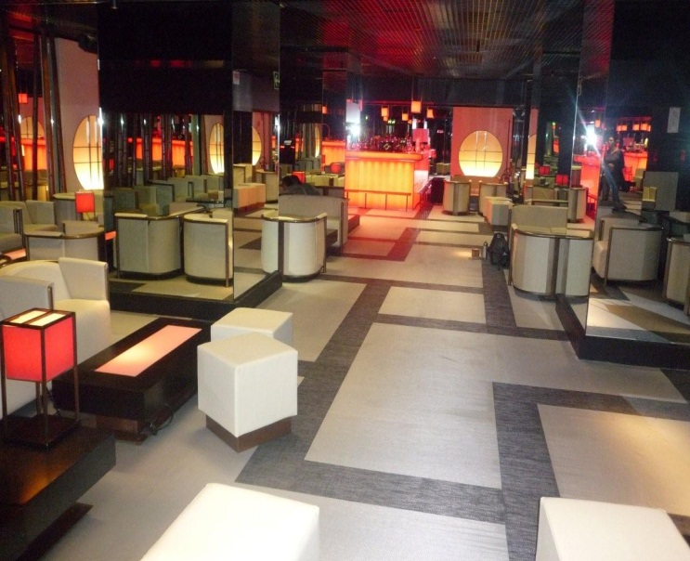
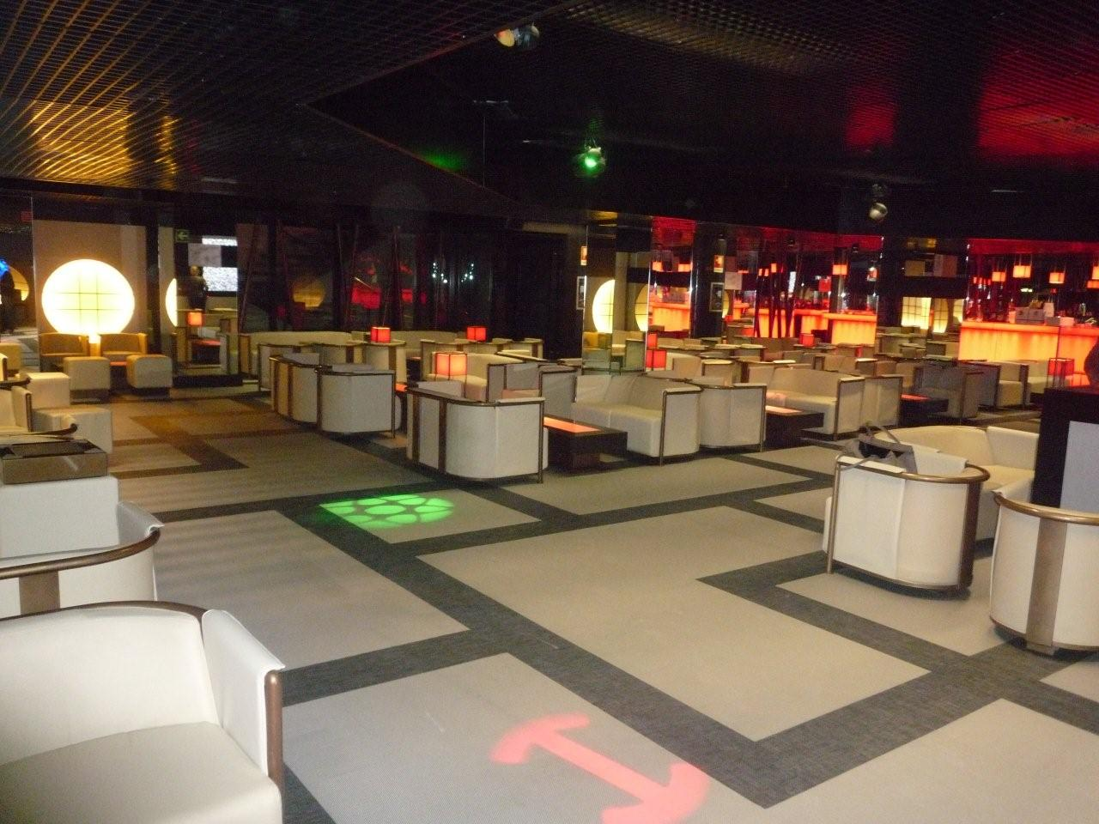
Discotheque Armani Priveé (Milano)

Slide 26
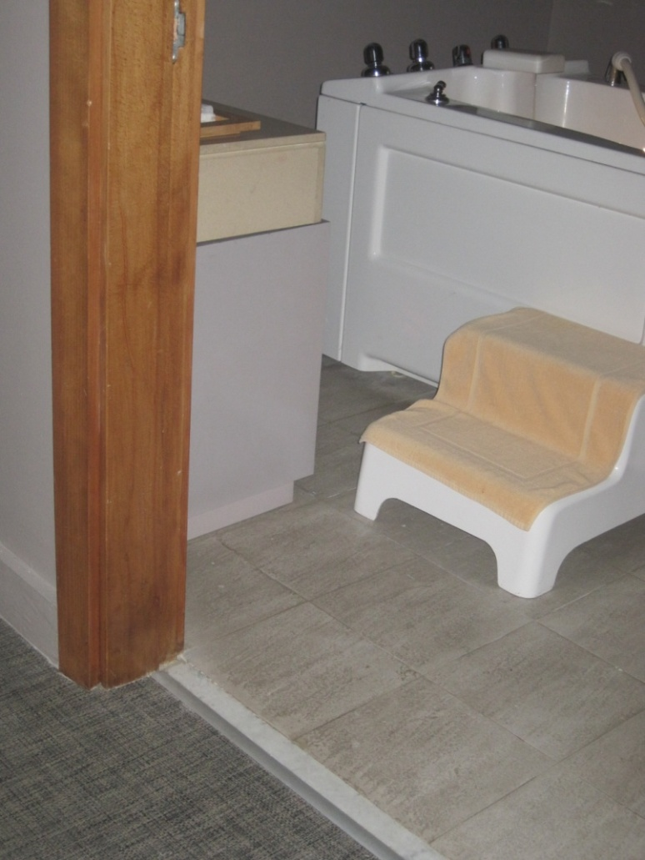
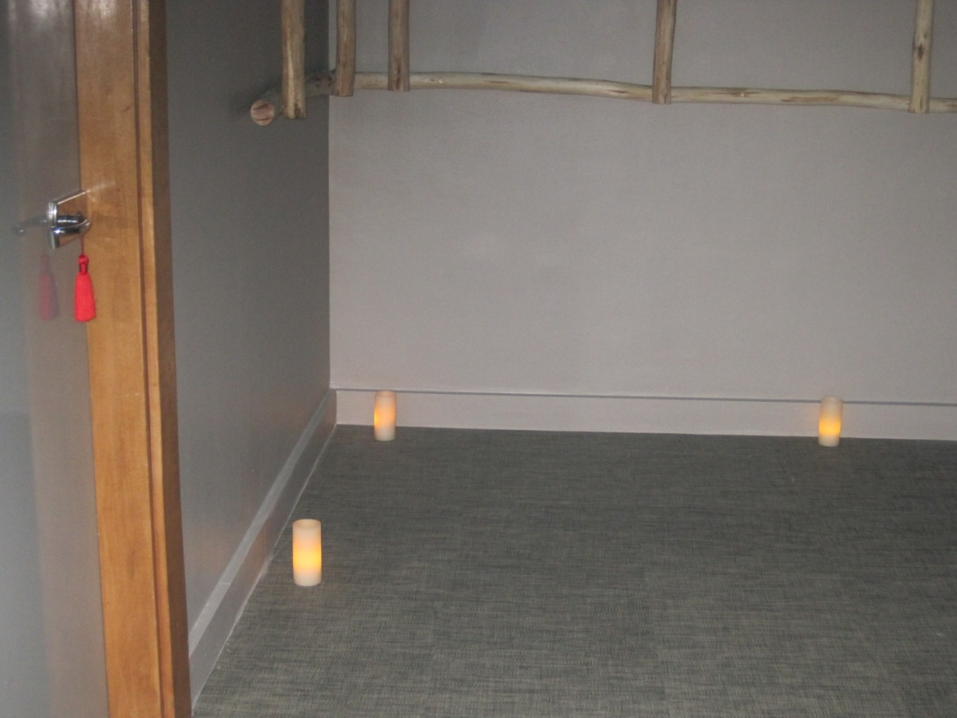
Hotel SPA Kenzi Towers (Casablanca)

Slide 27
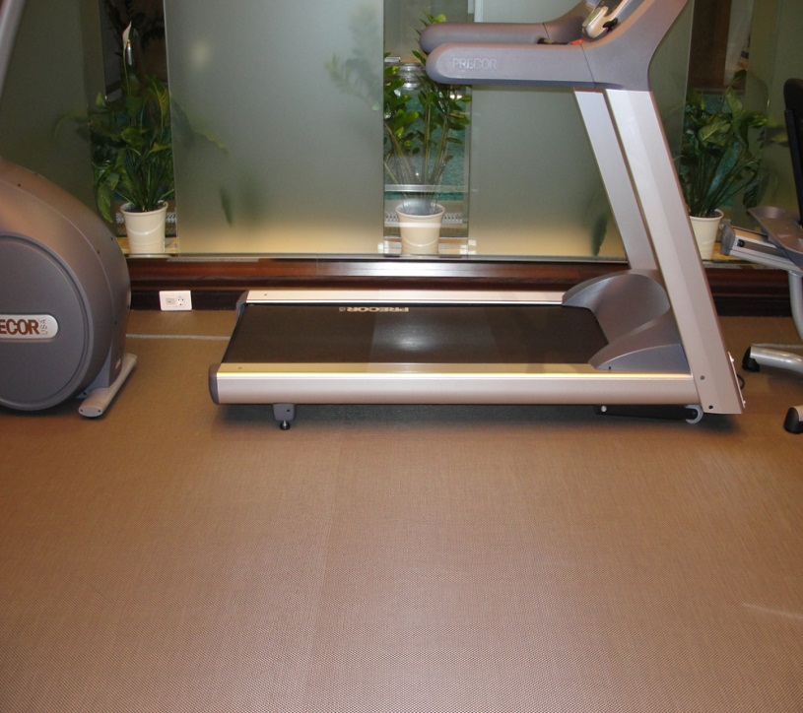
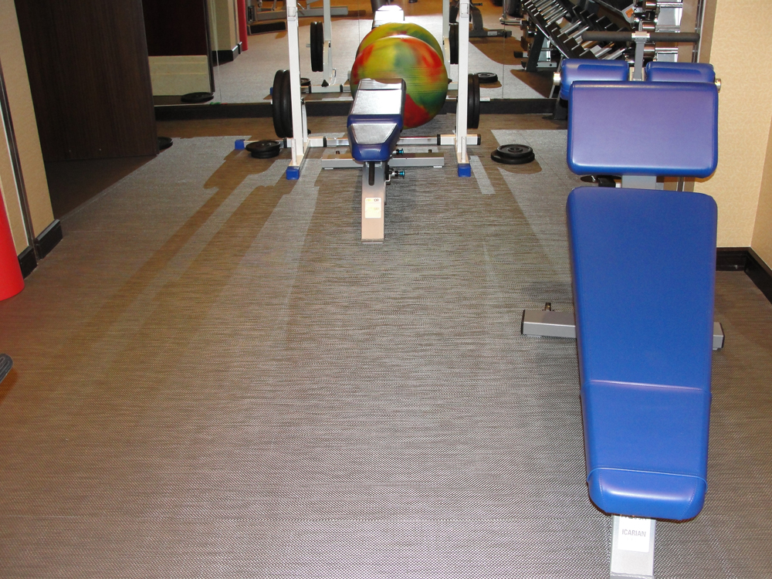
Hotel Hilton GYM (Ucrania)

Slide 28
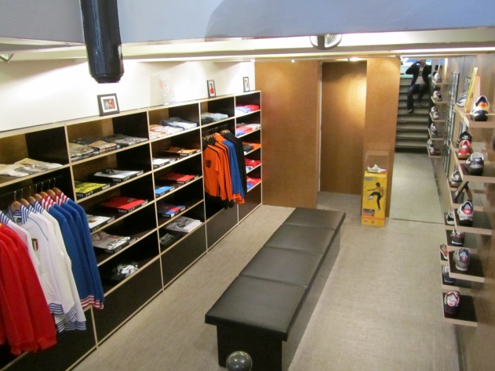
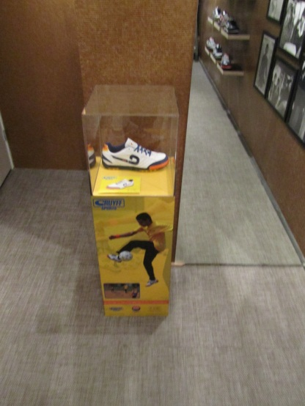
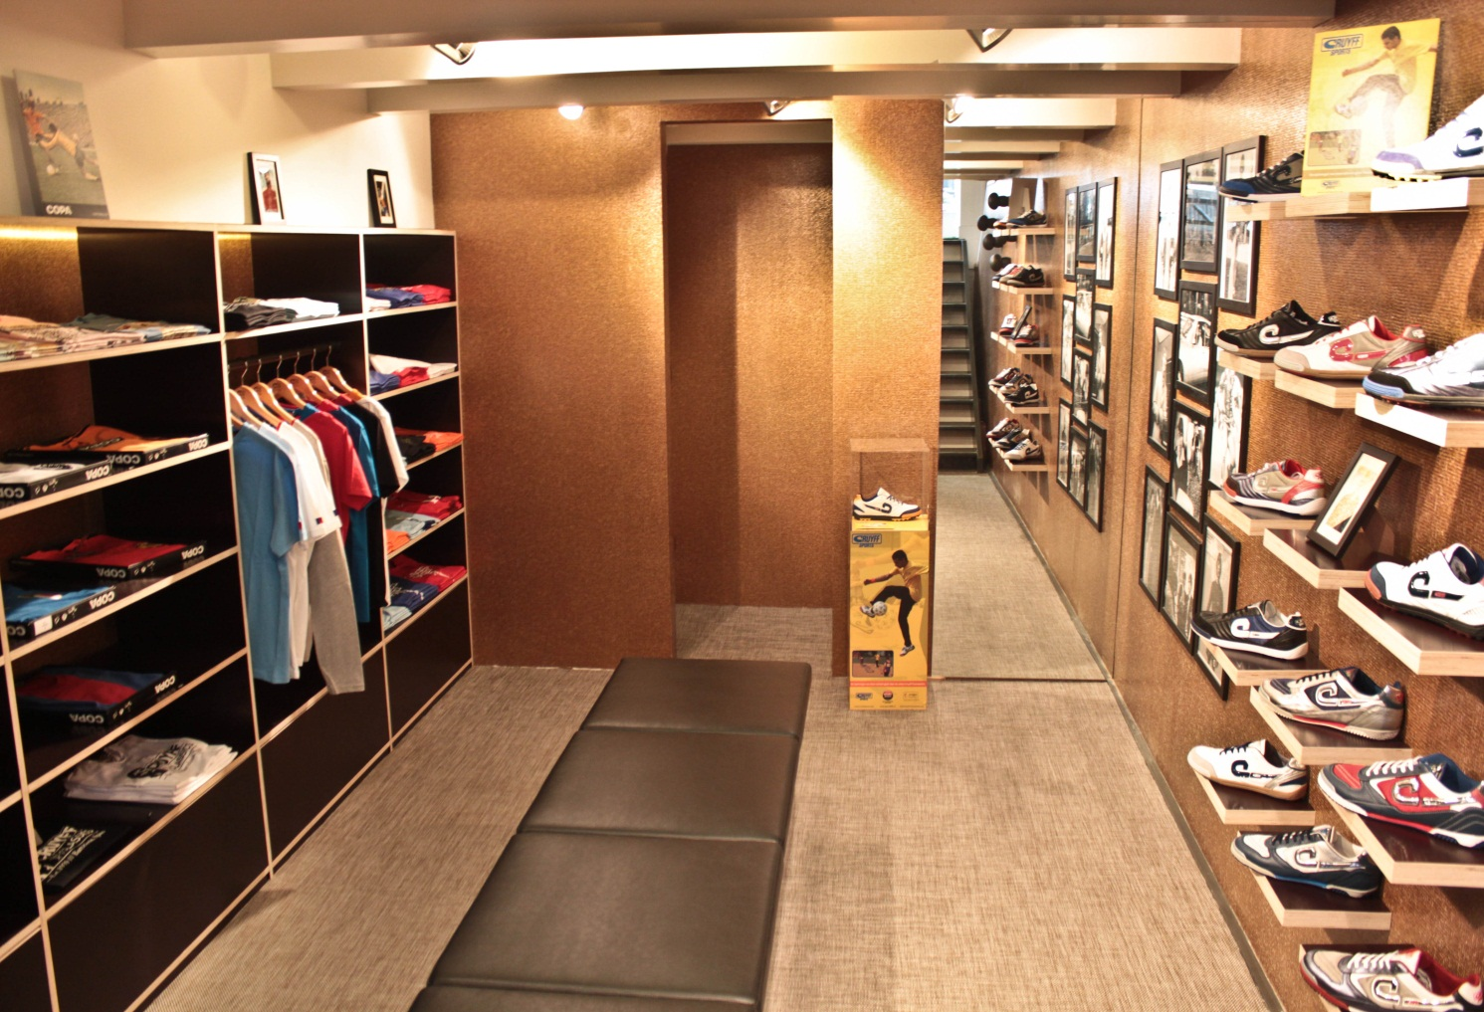
Cruyff Classics (Holland)

Slide 29
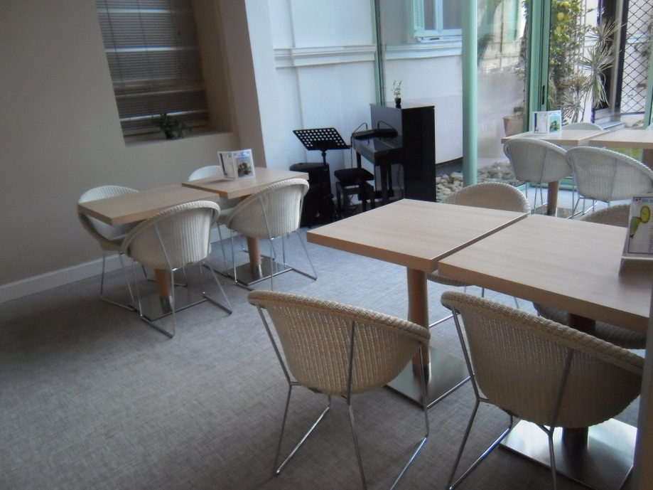
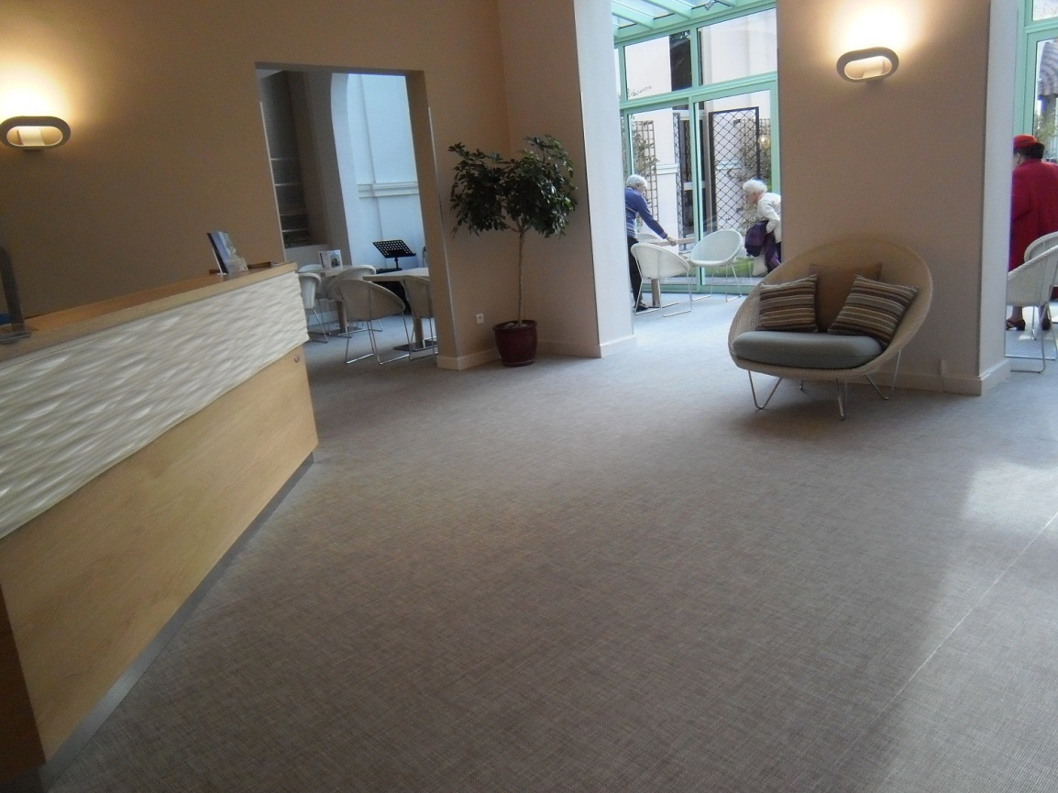
Hotel Balmoral Vacances Bleues, France

Slide 30
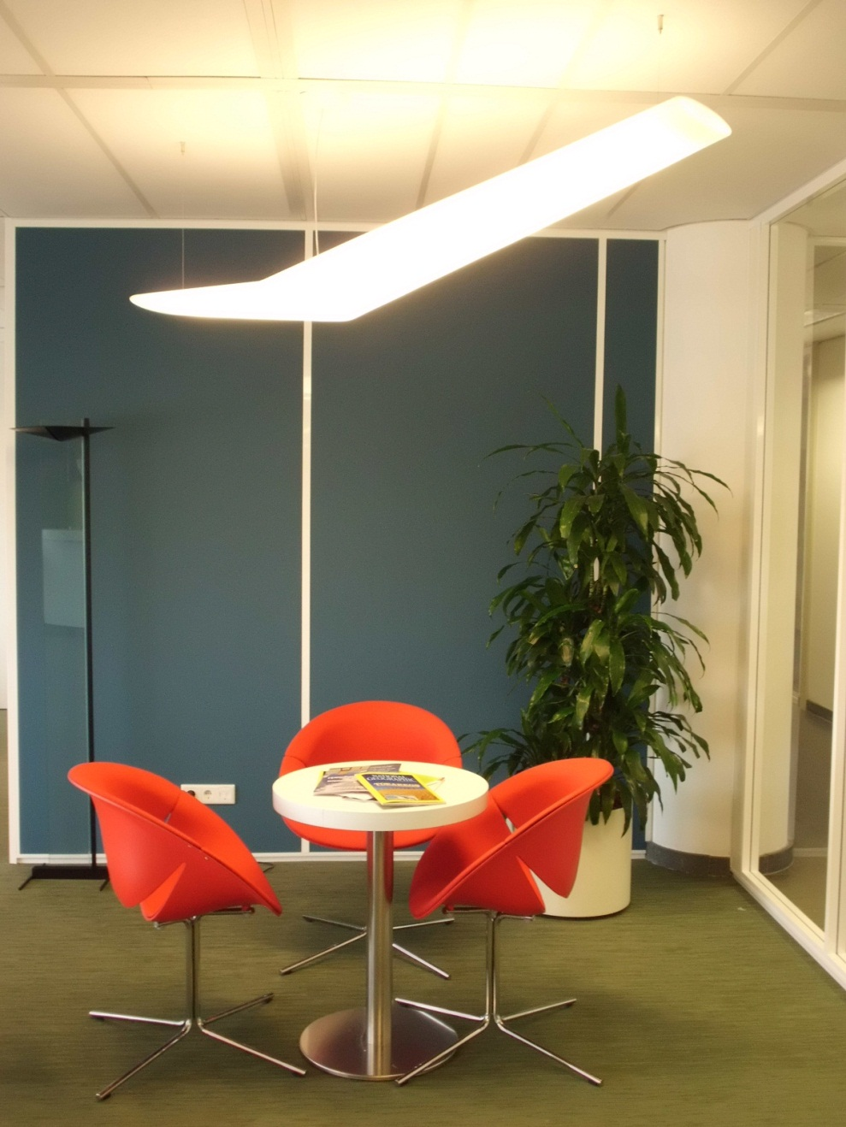
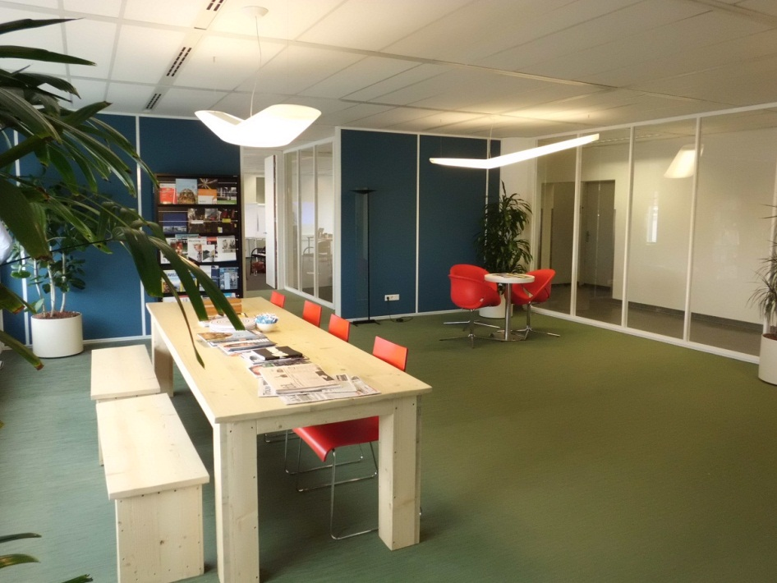
Schiphol College (Holland)

Slide 31
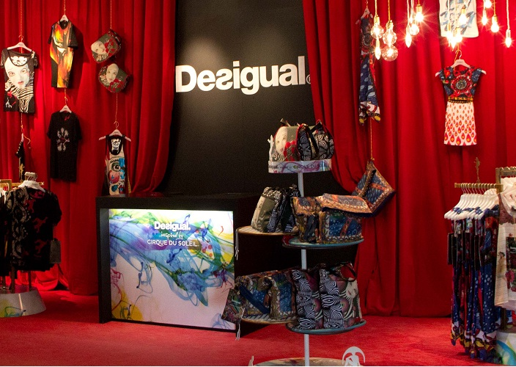
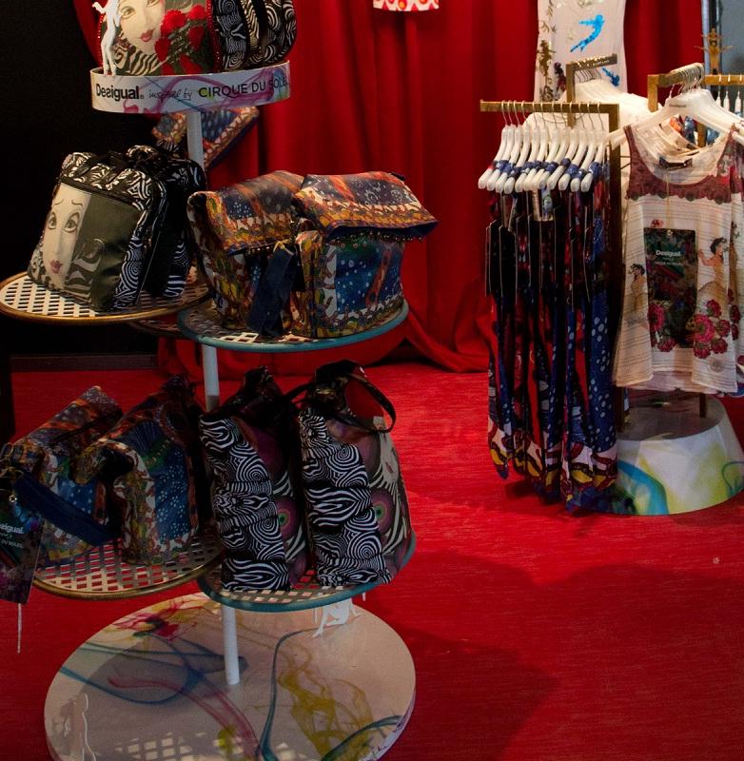
Desigual stand at Cirque du Soleil (Bacelon)

Slide 32
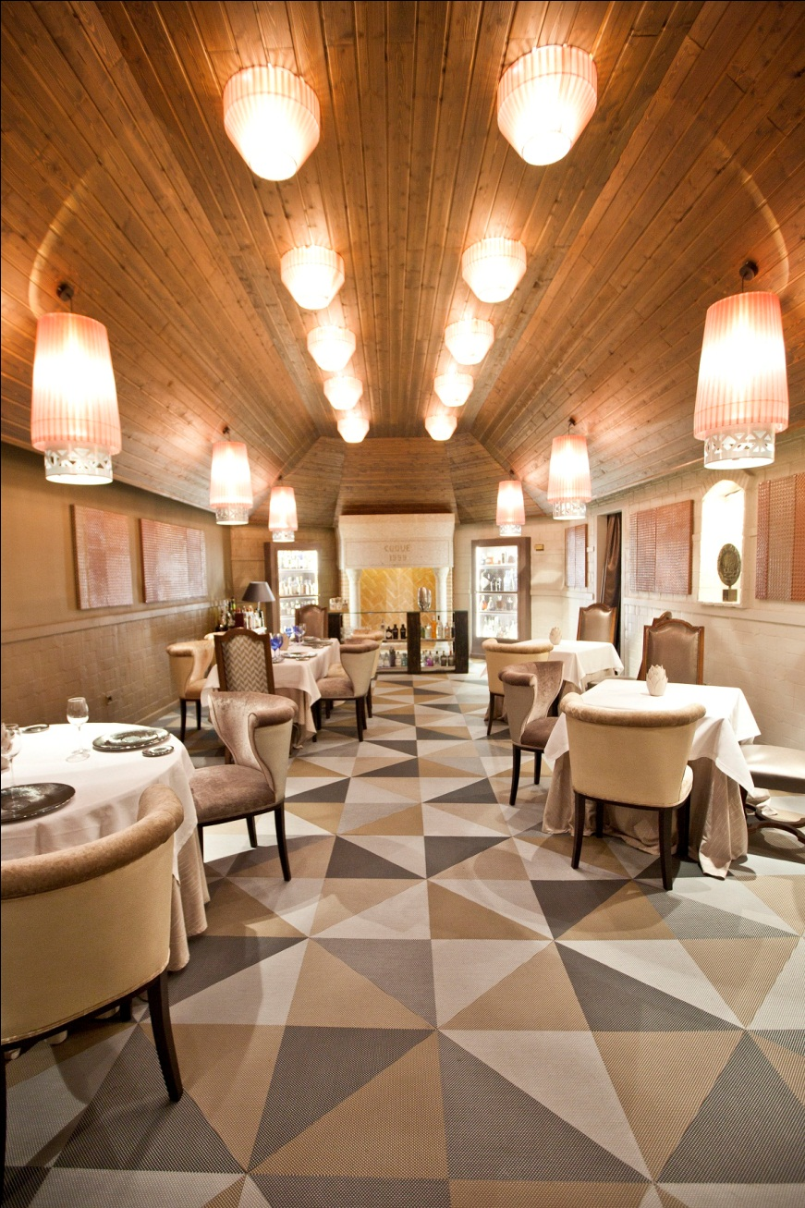
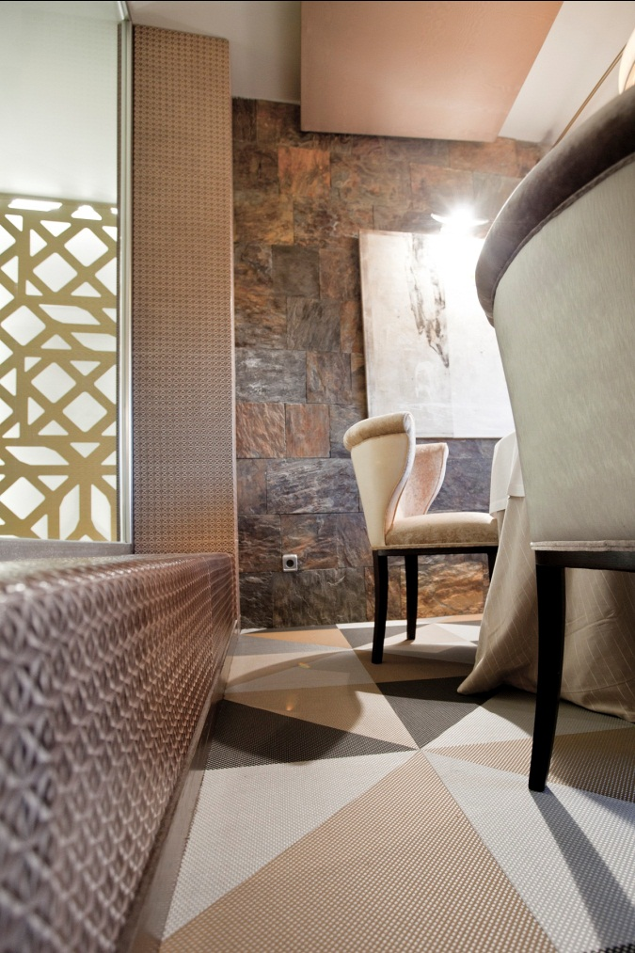
Coque’s Restaurant (Madrid)

Slide 33
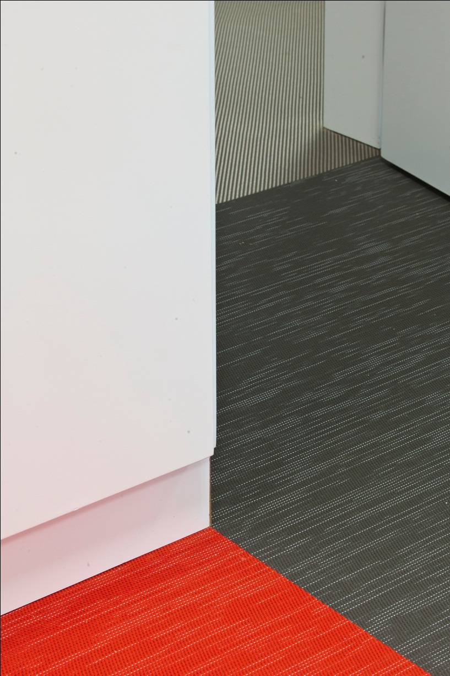
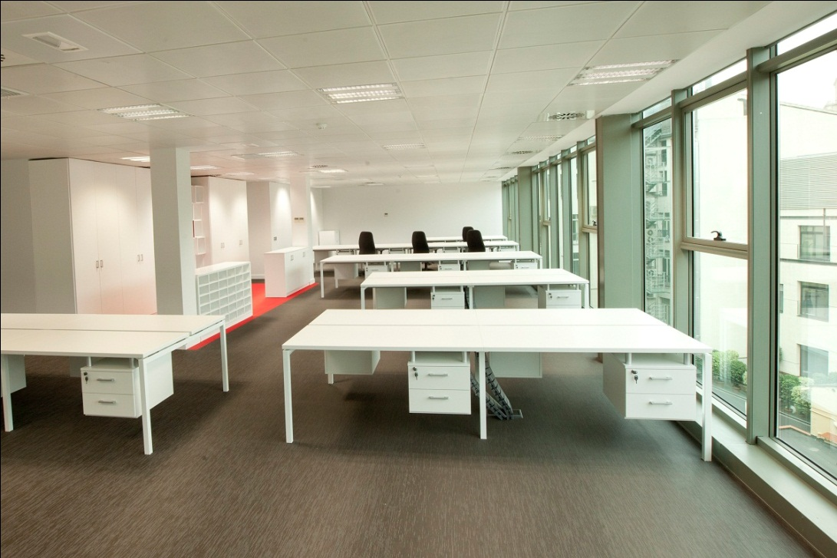
Michael Page Offices (Barcelona)

Slide 34
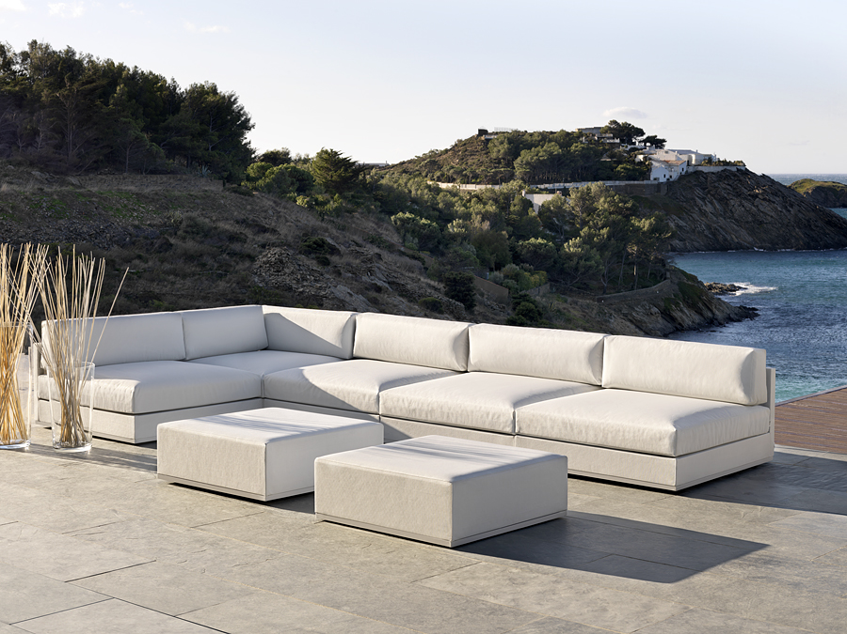
FITNICE upholstery

Slide 35

Thank you!

